Slide 1

EXPLORE · UNDERSTAND · APPLY
Symmetric and asymmetric encryption
Your message crosses
other people’s networks.
Who should be able
to understand it?
2.3 / PLAINTEXT · CIPHERTEXT · KEYS
Larry D. Moore · CC BY 4.0
IGCSE 0478 / ENCRYPTION
01
Notes:
Opening scenario: data passes through networks operated by others. Ask what happens if somebody copies the message. Teach concepts before exam questions. 60-minute selected route; full pack with follow-up practice.
Core source: teacher-supplied Hodder extract, printed pp.63–66, and Cambridge 0478 section 2.3. Eight practice parts are adapted from published 2024–2025 questions; 17 official marks retained. Original activities use suggested marks. The textbook quantum extension is outside this core lesson.
Photo: Internet_cafe_golden_princess.jpg
Author: Larry D. Moore
Source: https://commons.wikimedia.org/wiki/File:Internet_cafe_golden_princess.jpg
Licence: https://creativecommons.org/licenses/by/4.0/
Resized/recompressed; aspect-preserving crop in slide placement. No subject alterations. Representative hardware/settings; hypothetical lesson capabilities are not certified for the pictured products.

Slide 2
STARTER · DATA TRANSMISSION
Recall: how does a message travel?
A
B
C
Name packet part 1.
Name packet part 2.
Name packet part 3.
What routes the packet?
What helps reassemble it?
A correctly delivered packet can still contain data that somebody else can read.
IGCSE 0478 / ENCRYPTION
02
Notes:
Task 1: original retrieval from the existing packet-switching lesson. Choose (a), (b), (c) in five minutes. Header fields: originator/destination/packet number. Routers decide next hop. Checksums detect errors, not confidentiality.
Core source: teacher-supplied Hodder extract, printed pp.63–66, and Cambridge 0478 section 2.3. Eight practice parts are adapted from published 2024–2025 questions; 17 official marks retained. Original activities use suggested marks. The textbook quantum extension is outside this core lesson.

Slide 3

UNDERSTAND · PURPOSE
Some information should stay confidential
A medical summary
is being transmitted.
Encryption makes the data
unintelligible to someone
without the appropriate key.
Jason T. Poplin / US Navy · Public domain
It protects the meaning of intercepted data. It does not prevent the interception itself.
IGCSE 0478 / ENCRYPTION
03
Notes:
Encryption protects confidentiality when data is copied/intercepted. Sensitive examples: medical, bank, legal details. Photograph depicts historical paper medical records, not a particular encryption implementation.
Core source: teacher-supplied Hodder extract, printed pp.63–66, and Cambridge 0478 section 2.3. Eight practice parts are adapted from published 2024–2025 questions; 17 official marks retained. Original activities use suggested marks. The textbook quantum extension is outside this core lesson.
Photo: US_Navy_041019-N-5821P-019_Airman_Lauren_Thurgood_of_Las_Vegas,_Nev.,_pulls_patient_medical_records_in_the_inpatient_ward_aboard_the_conventionally_powered_aircraft_carrier_USS_Kitty_Hawk.jpg
Author: U.S. Navy photo by Photographer's Mate 3rd Class Jason T. Poplin
Source: https://commons.wikimedia.org/wiki/File:US_Navy_041019-N-5821P-019_Airman_Lauren_Thurgood_of_Las_Vegas%2C_Nev.%2C_pulls_patient_medical_records_in_the_inpatient_ward_aboard_the_conventionally_powered_aircraft_carrier_USS_Kitty_Hawk.jpg
Licence: https://commons.wikimedia.org/wiki/File:US_Navy_041019-N-5821P-019_Airman_Lauren_Thurgood_of_Las_Vegas%2C_Nev.%2C_pulls_patient_medical_records_in_the_inpatient_ward_aboard_the_conventionally_powered_aircraft_carrier_USS_Kitty_Hawk.jpg#Licensing
Resized/recompressed; aspect-preserving crop in slide placement. No subject alterations. Representative hardware/settings; hypothetical lesson capabilities are not certified for the pictured products.

Slide 4
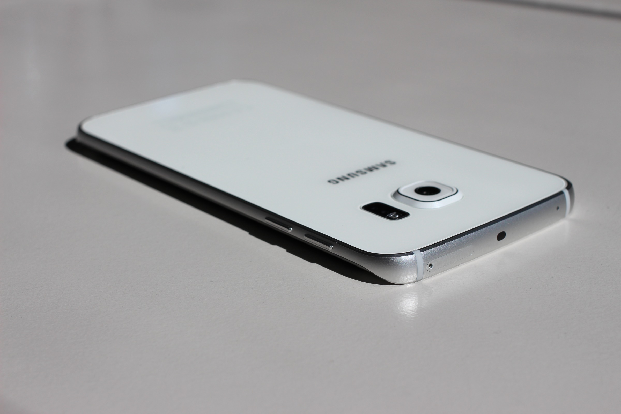
UNDERSTAND · VOCABULARY
Before and after encryption
PLAINTEXT
MEET AT NINE
CIPHERTEXT
PHHW DW QLQH
Maurizio Pesce · CC BY 2.0
A message sent from a phone
The example uses a simple letter shift so we can see the transformation. It is not a secure cipher.
IGCSE 0478 / ENCRYPTION
04
Notes:
Plaintext is the original intelligible data. Ciphertext is the encrypted data. Both plain text/plaintext and cipher text/ciphertext used in papers. The phone photograph represents a device sending a message, not the example’s actual sender.
Core source: teacher-supplied Hodder extract, printed pp.63–66, and Cambridge 0478 section 2.3. Eight practice parts are adapted from published 2024–2025 questions; 17 official marks retained. Original activities use suggested marks. The textbook quantum extension is outside this core lesson.
Photo: Samsung_Galaxy_S6_edge_(17448278539).jpg
Author: Maurizio Pesce from Milan, Italia
Source: https://commons.wikimedia.org/wiki/File:Samsung_Galaxy_S6_edge_%2817448278539%29.jpg
Licence: https://creativecommons.org/licenses/by/2.0/
Resized/recompressed; aspect-preserving crop in slide placement. No subject alterations. Representative hardware/settings; hypothetical lesson capabilities are not certified for the pictured products.

Slide 5
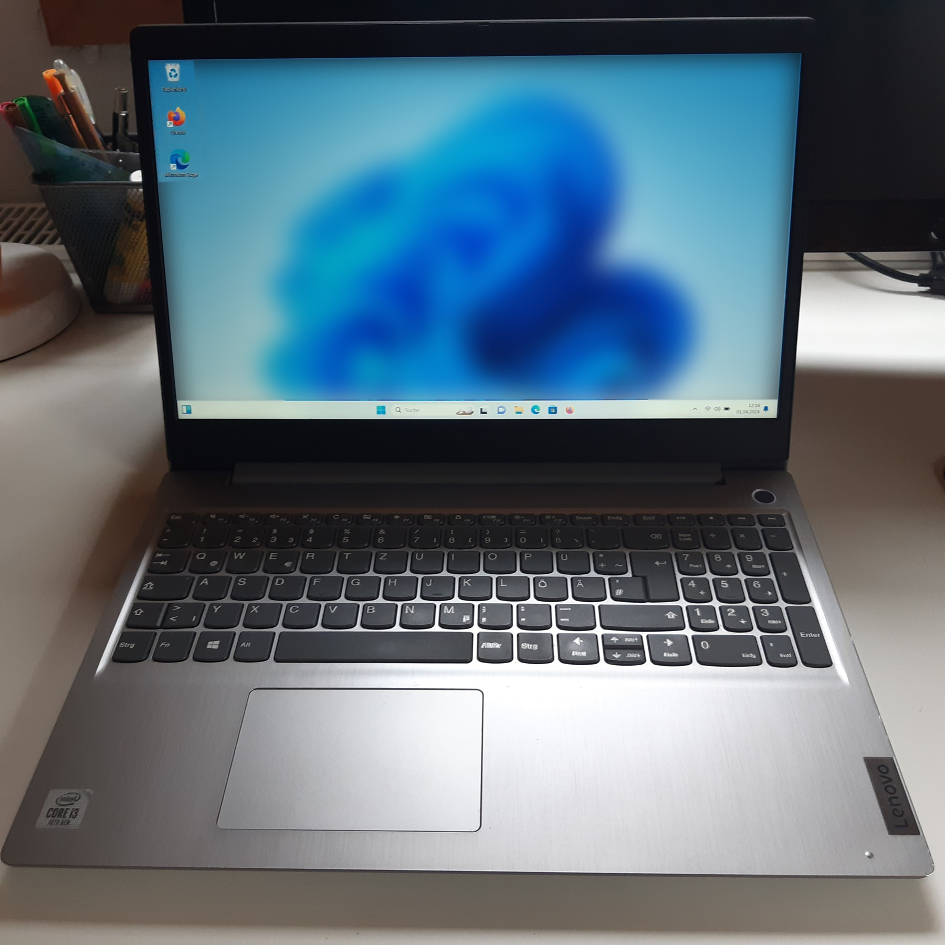
UNDERSTAND · MECHANISM
An algorithm and a key do different jobs
ALGORITHM
Shift each letter through the alphabet.
KEY
How far to shift: 3 places.
Nasenber3 · CC BY-SA 4.0
Same method + a different key → a different ciphertext.
IGCSE 0478 / ENCRYPTION
05
Notes:
Algorithm = method/procedure. Key = value supplied to the algorithm. Avoid the inaccurate 2025 Q6(a) phrasing calling the encryption key a type of algorithm. Key examples are illustrative; real cryptographic keys are not passwords by definition.
Core source: teacher-supplied Hodder extract, printed pp.63–66, and Cambridge 0478 section 2.3. Eight practice parts are adapted from published 2024–2025 questions; 17 official marks retained. Original activities use suggested marks. The textbook quantum extension is outside this core lesson.
Photo: Lenovo_Ideapad_3_20240401_121836.jpg
Author: Nasenber3
Source: https://commons.wikimedia.org/wiki/File:Lenovo_Ideapad_3_20240401_121836.jpg
Licence: https://creativecommons.org/licenses/by-sa/4.0/
Resized/recompressed; uncropped aspect-preserving placement. No subject alterations. Representative hardware/settings; hypothetical lesson capabilities are not certified for the pictured products.

Slide 6
EXPLORE · TOY CIPHER
Try a transformation you can follow
Plain letter | M | E | E | T
Shift forward | +3 | +3 | +3 | +3
Cipher letter | P | H | H | W
MEET → PHHW
Now reverse the operation. What should happen to P, H, H and W?
IGCSE 0478 / ENCRYPTION
06
Notes:
Worked example key3; worksheet uses different plaintext and key4. Wrap after Z. Caesar cipher is a visual demonstration only, not recommended security. Spaces preserved.
Core source: teacher-supplied Hodder extract, printed pp.63–66, and Cambridge 0478 section 2.3. Eight practice parts are adapted from published 2024–2025 questions; 17 official marks retained. Original activities use suggested marks. The textbook quantum extension is outside this core lesson.

Slide 7
UNDERSTAND · RECOVER THE PLAINTEXT
Decryption reverses the transformation
ENCRYPT
DECRYPT
MEET → PHHW
PHHW → MEET
Key value: 3
Key value: 3
Same key value. The decryption algorithm reverses what encryption did.
IGCSE 0478 / ENCRYPTION
07
Notes:
Use same key value3; encrypt shift forward3, decrypt shift backward3. The reversed operation does not mean that this toy cipher uses a second secret key. Real algorithms are more complex.
Core source: teacher-supplied Hodder extract, printed pp.63–66, and Cambridge 0478 section 2.3. Eight practice parts are adapted from published 2024–2025 questions; 17 official marks retained. Original activities use suggested marks. The textbook quantum extension is outside this core lesson.

Slide 8
UNDERSTAND · SYMMETRIC ENCRYPTION
Symmetric: both ends use the same key
SENDER
RECEIVER
Plaintext → ciphertext
Ciphertext → plaintext
Ciphertext travels
Shared secret key K
The SAME key K
The ciphertext may be copied. Keep the shared secret key protected.
IGCSE 0478 / ENCRYPTION
08
Notes:
An encryption algorithm uses a shared secret key. Sender and receiver both know it. Same key encrypts/decrypts. Do not introduce exam allocations here.
Core source: teacher-supplied Hodder extract, printed pp.63–66, and Cambridge 0478 section 2.3. Eight practice parts are adapted from published 2024–2025 questions; 17 official marks retained. Original activities use suggested marks. The textbook quantum extension is outside this core lesson.

Slide 9
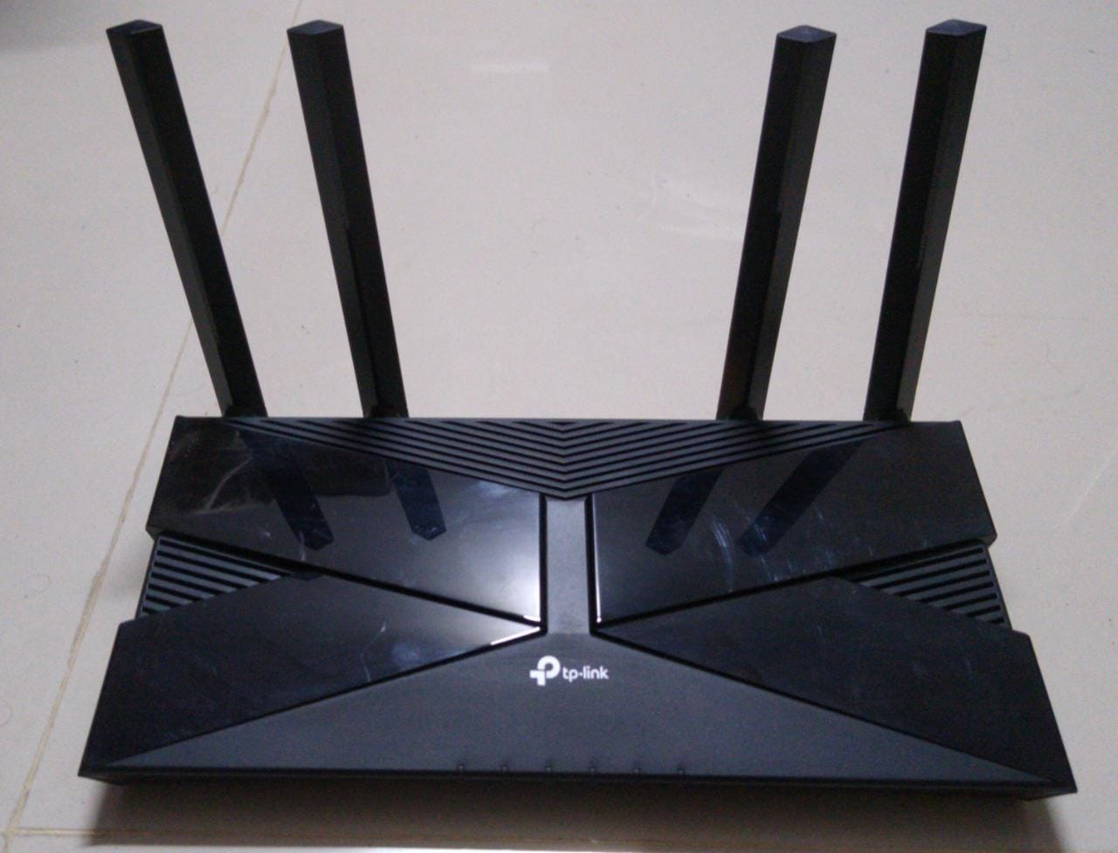
UNDERSTAND · KEY DISTRIBUTION
The difficult part: sharing the secret
Both people need K.
If an eavesdropper gets
both the ciphertext and K,
what can they recover?
Abhi25t · CC BY-SA 4.0
The key needs a protected way to reach the receiver; transmitting the secret openly defeats the protection.
IGCSE 0478 / ENCRYPTION
09
Notes:
Symmetric key distribution is a problem if a secret is sent over an insecure channel. Teach protected transfer/established secure methods, not sending a secret beside the ciphertext in plaintext. Photo is representative routing hardware.
Core source: teacher-supplied Hodder extract, printed pp.63–66, and Cambridge 0478 section 2.3. Eight practice parts are adapted from published 2024–2025 questions; 17 official marks retained. Original activities use suggested marks. The textbook quantum extension is outside this core lesson.
Photo: TP-Link_AX1500_Wi-Fi_6_Router_Front.jpg
Author: Abhi25t
Source: https://commons.wikimedia.org/wiki/File:TP-Link_AX1500_Wi-Fi_6_Router_Front.jpg
Licence: https://creativecommons.org/licenses/by-sa/4.0/
Resized/recompressed; uncropped aspect-preserving placement. No subject alterations. Representative hardware/settings; hypothetical lesson capabilities are not certified for the pictured products.

Slide 10
APPLY · CONFIDENTIALITY
Receiving a copy is not understanding it
SENDER
NETWORK
RECEIVER
Encrypts the data
Carries ciphertext
Decrypts with the key
EAVESDROPPER
May obtain a copy of ciphertext.
A checksum checks whether data changed. Encryption protects the original meaning.
IGCSE 0478 / ENCRYPTION
10
Notes:
Check: encryption does not stop packets being captured. Distinguish confidentiality from checksum error detection. Show simplified network flow, not actual cryptographic protocol.
Core source: teacher-supplied Hodder extract, printed pp.63–66, and Cambridge 0478 section 2.3. Eight practice parts are adapted from published 2024–2025 questions; 17 official marks retained. Original activities use suggested marks. The textbook quantum extension is outside this core lesson.

Slide 11

UNDERSTAND · ASYMMETRIC ENCRYPTION
Asymmetric: a matching pair of keys
PUBLIC KEY
Made available to others.
PRIVATE KEY
Kept secret by its owner.
Shixart1985 · CC BY 2.0
Publishing the public key does not mean publishing the private key.
IGCSE 0478 / ENCRYPTION
11
Notes:
Public key can be shared; private key kept by owner. Keys mathematically linked; deriving private from public should be computationally infeasible with suitable cryptography. Do not repeat textbook’s absolute claim that neither key can be derived from the other. Photograph is representative remote working.
Core source: teacher-supplied Hodder extract, printed pp.63–66, and Cambridge 0478 section 2.3. Eight practice parts are adapted from published 2024–2025 questions; 17 official marks retained. Original activities use suggested marks. The textbook quantum extension is outside this core lesson.
Photo: Child_playing_while_parent_works_on_laptop_at_home_during_daytime.jpg
Author: Shixart1985
Source: https://commons.wikimedia.org/wiki/File:Child_playing_while_parent_works_on_laptop_at_home_during_daytime.jpg
Licence: https://creativecommons.org/licenses/by/2.0/
Resized/recompressed; uncropped aspect-preserving placement. No subject alterations. Representative hardware/settings; hypothetical lesson capabilities are not certified for the pictured products.

Slide 12
UNDERSTAND · KEY OWNERSHIP
To Ben: use Ben’s key pair
AISHA
BEN
Wants to send a file to Ben.
Owns the matching key pair.
Ben’s PUBLIC key
May be shared
Ben’s PRIVATE key
Aisha needs Ben’s public key. She does not need Ben’s private key.
IGCSE 0478 / ENCRYPTION
12
Notes:
Worked confidentiality example Aisha→Ben. Ben creates matching public/private keys. Aisha obtains Ben’s public key. She encrypts with it; Ben decrypts with his private. For real applications, authenticate whose public key it is; authenticity mechanisms outside core.
Core source: teacher-supplied Hodder extract, printed pp.63–66, and Cambridge 0478 section 2.3. Eight practice parts are adapted from published 2024–2025 questions; 17 official marks retained. Original activities use suggested marks. The textbook quantum extension is outside this core lesson.

Slide 13
UNDERSTAND · WORKED PROCESS
Send ciphertext; keep the private key
01
Ben creates a matching public/private key pair.
02
Ben shares his public key with Aisha.
03
Aisha encrypts the file using Ben’s public key.
04
She sends the ciphertext to Ben.
05
Ben decrypts it using his private key.
The private key stays with Ben throughout the exchange.
IGCSE 0478 / ENCRYPTION
13
Notes:
Use the receiver’s public key to encrypt and receiver’s matching private key to decrypt. This is confidentiality, not digital signatures. Names differ from worksheet Maya/Leo.
Core source: teacher-supplied Hodder extract, printed pp.63–66, and Cambridge 0478 section 2.3. Eight practice parts are adapted from published 2024–2025 questions; 17 official marks retained. Original activities use suggested marks. The textbook quantum extension is outside this core lesson.

Slide 14
APPLY · TWO-WAY MESSAGES
A reply needs the other person’s keys
AISHA → BEN
BEN → AISHA
Ben’s public key encrypts.
Ben’s private key decrypts.
Whose public key encrypts?
Whose private key decrypts?
Follow the recipient, not the original sender.
Explain the reply without using “the key” when its owner or type matters.
IGCSE 0478 / ENCRYPTION
14
Notes:
Before revealing prompt answer in notes, ask who owns keys when Ben replies to Aisha: Aisha publishes her public key; Ben uses Aisha public to encrypt; Aisha decrypts with her own private. Both need own pairs for two-way confidentiality.
Core source: teacher-supplied Hodder extract, printed pp.63–66, and Cambridge 0478 section 2.3. Eight practice parts are adapted from published 2024–2025 questions; 17 official marks retained. Original activities use suggested marks. The textbook quantum extension is outside this core lesson.

Slide 15
CONSOLIDATE · BEFORE PRACTICE
Same goal; different key arrangements
Feature | Symmetric | Asymmetric
Keys | One shared secret key | A public/private pair
Encrypt | Shared secret key | Recipient’s public key
Decrypt | The same shared key | Recipient’s private key
Share / protect | Both ends need the secret securely | Share public; keep private secret
Both transform plaintext into ciphertext using an algorithm and key(s).
IGCSE 0478 / ENCRYPTION
15
Notes:
Contrast actual methods, not universal security ranking. Symmetric shared secret; asymmetric public/private pair. Real systems often combine methods; this is contextual note, not required 0478 mechanism.
Core source: teacher-supplied Hodder extract, printed pp.63–66, and Cambridge 0478 section 2.3. Eight practice parts are adapted from published 2024–2025 questions; 17 official marks retained. Original activities use suggested marks. The textbook quantum extension is outside this core lesson.

Slide 16
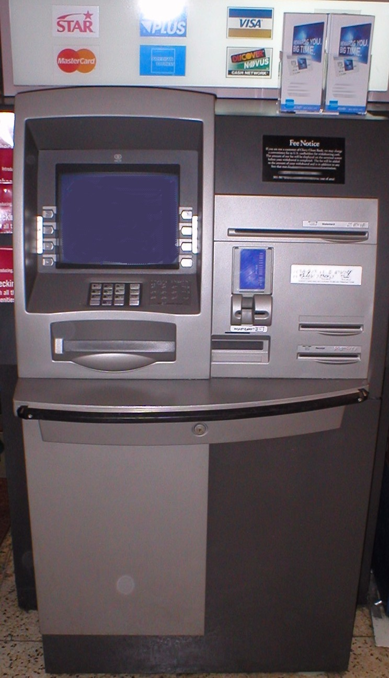
CHECK UNDERSTANDING
Explain a new situation before practising
01
Someone captures transmitted account data. Does encryption prevent that copy?
02
A bank is the recipient. Whose public key is needed?
03
Who should keep the matching private key?
Rfc1394 · Public domain
Explain the mechanism. Then use its terms precisely.
IGCSE 0478 / ENCRYPTION
16
Notes:
Photo of ATM represents sensitive financial data, not a claimed particular cryptographic implementation. Ask original unmarked checks before exam framing; answer notes: encryption protects confidentiality, not interception; chosen recipient public key; recipient private to decrypt.
Core source: teacher-supplied Hodder extract, printed pp.63–66, and Cambridge 0478 section 2.3. Eight practice parts are adapted from published 2024–2025 questions; 17 official marks retained. Original activities use suggested marks. The textbook quantum extension is outside this core lesson.
Photo: ATM_750x1300.jpg
Author: Rfc1394 at English Wikipedia Later versions were uploaded by Awyong Jeffrey Mordecai Salleh at en.wikipedia .
Source: https://commons.wikimedia.org/wiki/File:ATM_750x1300.jpg
Licence: https://commons.wikimedia.org/wiki/File:ATM_750x1300.jpg#Licensing
Resized/recompressed; uncropped aspect-preserving placement. No subject alterations. Representative hardware/settings; hypothetical lesson capabilities are not certified for the pictured products.

Slide 17
EXAM PRACTICE · TRANSITION
Now turn the ideas into clear answers
Name what changes.
Explain which key is used.
Identify who owns it.
Read the question’s scope.
Give distinct ideas rather than repeating “secure”.
IGCSE 0478 / ENCRYPTION
17
Notes:
Concepts and original understanding checks completed. Tasks2–5 selected exam/original practice; Task6 follows as original repair bank. 17 published marks +34 suggested marks overall. Full pack not required in one hour.
Core source: teacher-supplied Hodder extract, printed pp.63–66, and Cambridge 0478 section 2.3. Eight practice parts are adapted from published 2024–2025 questions; 17 official marks retained. Original activities use suggested marks. The textbook quantum extension is outside this core lesson.

Slide 18
EXAM PRACTICE
Explain the purpose
QUESTION 1 / 1 MARK
State the purpose of encrypting data before it is transmitted.
Attempt independently. Discuss the reasoning before checking the model answer.
0478/12 Feb/Mar 2024 Q7(a)(i)
IGCSE 0478 / ENCRYPTION
18
Notes:
Task2: define terms, answer cited purpose question and explain why interception is not prevented. Attempt before feedback.
Core source: teacher-supplied Hodder extract, printed pp.63–66, and Cambridge 0478 section 2.3. Eight practice parts are adapted from published 2024–2025 questions; 17 official marks retained. Original activities use suggested marks. The textbook quantum extension is outside this core lesson.
0478/12 Feb/Mar 2024 Q7(a)(i)
QP: https://pastpapers.papacambridge.com/directories/CAIE/CAIE-pastpapers/upload/0478_m24_qp_12.pdf
MS: https://pastpapers.papacambridge.com/directories/CAIE/CAIE-pastpapers/upload/0478_m24_ms_12.pdf

Slide 19
FEEDBACK · AFTER PRACTICE
Meaning can be protected after interception
01
The intercepted data cannot be understood without the appropriate key.
INTERCEPTED
MEANING PROTECTED
Ciphertext can still be copied.
Original meaning stays protected.
“It cannot be intercepted” confuses delivery with confidentiality.
0478/12 Feb/Mar 2024 Q7(a)(i)
IGCSE 0478 / ENCRYPTION
19
Notes:
Show only after the matching question has been attempted. These are model routes; retain accepted alternatives in the teacher key. Encryption does not stop interception. Explain unreadability, rather than claiming interception is prevented.
Core source: teacher-supplied Hodder extract, printed pp.63–66, and Cambridge 0478 section 2.3. Eight practice parts are adapted from published 2024–2025 questions; 17 official marks retained. Original activities use suggested marks. The textbook quantum extension is outside this core lesson.
0478/12 Feb/Mar 2024 Q7(a)(i)
QP: https://pastpapers.papacambridge.com/directories/CAIE/CAIE-pastpapers/upload/0478_m24_qp_12.pdf
MS: https://pastpapers.papacambridge.com/directories/CAIE/CAIE-pastpapers/upload/0478_m24_ms_12.pdf

Slide 20
EXAM PRACTICE
Explain symmetric encryption
QUESTION 1 / 4 MARKS
Explain how data is encrypted using symmetric encryption.
Attempt independently. Discuss the reasoning before checking the model answer.
0478/12 May/June 2024 Q2(c)(i)
IGCSE 0478 / ENCRYPTION
20
Notes:
Attempt Task3(a) before feedback. Task3(b) toy cipher uses different values from teaching example.
Core source: teacher-supplied Hodder extract, printed pp.63–66, and Cambridge 0478 section 2.3. Eight practice parts are adapted from published 2024–2025 questions; 17 official marks retained. Original activities use suggested marks. The textbook quantum extension is outside this core lesson.
0478/12 May/June 2024 Q2(c)(i)
QP: https://pastpapers.papacambridge.com/directories/CAIE/CAIE-pastpapers/upload/0478_s24_qp_12.pdf
MS: https://pastpapers.papacambridge.com/directories/CAIE/CAIE-pastpapers/upload/0478_s24_ms_12.pdf

Slide 21
FEEDBACK · AFTER PRACTICE
The same-key point is essential
01
Plaintext is transformed into ciphertext.
02
An encryption algorithm performs the transformation.
03
The algorithm uses a shared secret key.
04
The receiver uses the SAME key to decrypt.
The scheme requires the same-key idea, plus up to three other accepted points.
0478/12 May/June 2024 Q2(c)(i)
IGCSE 0478 / ENCRYPTION
21
Notes:
Show only after the matching question has been attempted. These are model routes; retain accepted alternatives in the teacher key. One mark requires the same-key idea; award up to three other accepted points. A key is a value used by the algorithm, not the algorithm itself.
Core source: teacher-supplied Hodder extract, printed pp.63–66, and Cambridge 0478 section 2.3. Eight practice parts are adapted from published 2024–2025 questions; 17 official marks retained. Original activities use suggested marks. The textbook quantum extension is outside this core lesson.
0478/12 May/June 2024 Q2(c)(i)
QP: https://pastpapers.papacambridge.com/directories/CAIE/CAIE-pastpapers/upload/0478_s24_qp_12.pdf
MS: https://pastpapers.papacambridge.com/directories/CAIE/CAIE-pastpapers/upload/0478_s24_ms_12.pdf

Slide 22
EXAM PRACTICE
Choose the correct terms
QUESTION 1 / 4 MARKS
Complete the asymmetric-encryption description using the word bank. Use each term at most once.
Attempt independently. Discuss the reasoning before checking the model answer.
0478/11 May/June 2024 Q7
IGCSE 0478 / ENCRYPTION
22
Notes:
Task4(a) four-gap paragraph is printed on worksheet/booklet. Then annotate the different Maya/Leo direction scenario independently. Do not show matching answer until attempted.
Core source: teacher-supplied Hodder extract, printed pp.63–66, and Cambridge 0478 section 2.3. Eight practice parts are adapted from published 2024–2025 questions; 17 official marks retained. Original activities use suggested marks. The textbook quantum extension is outside this core lesson.
0478/11 May/June 2024 Q7
QP: https://pastpapers.papacambridge.com/directories/CAIE/CAIE-pastpapers/upload/0478_s24_qp_11.pdf
MS: https://pastpapers.papacambridge.com/directories/CAIE/CAIE-pastpapers/upload/0478_s24_ms_11.pdf

Slide 23
FEEDBACK · AFTER PRACTICE
Check the four terms and their roles
01
Plaintext: original understandable data.
02
Ciphertext: encrypted data.
03
Public key: used to encrypt for its owner.
04
Private key: used by the recipient to decrypt.
For a confidential message to Leo: Leo’s public key → Leo’s private key.
0478/11 May/June 2024 Q7
IGCSE 0478 / ENCRYPTION
23
Notes:
Show only after the matching question has been attempted. These are model routes; retain accepted alternatives in the teacher key. For confidential transmission, encrypt with the recipient’s public key and decrypt with the recipient’s private key.
Core source: teacher-supplied Hodder extract, printed pp.63–66, and Cambridge 0478 section 2.3. Eight practice parts are adapted from published 2024–2025 questions; 17 official marks retained. Original activities use suggested marks. The textbook quantum extension is outside this core lesson.
0478/11 May/June 2024 Q7
QP: https://pastpapers.papacambridge.com/directories/CAIE/CAIE-pastpapers/upload/0478_s24_qp_11.pdf
MS: https://pastpapers.papacambridge.com/directories/CAIE/CAIE-pastpapers/upload/0478_s24_ms_11.pdf

Slide 24
EXAM PRACTICE
Make a comparison, not two vague claims
QUESTION 1 / 4 MARKS
Describe the differences between symmetric and asymmetric encryption.
QUESTION 2 / 1 MARK
Give one similarity between symmetric and asymmetric encryption.
Attempt independently. Discuss the reasoning before checking the model answer.
0478/12 Feb/Mar 2024 Q7(a)(ii) · 0478/13 Oct/Nov 2024 Q2(g)(ii)
IGCSE 0478 / ENCRYPTION
24
Notes:
Task5 has comparison, similarity, reason for asymmetric, a one-selection MC item and naming the other method. Use remaining parts as follow-up if time short.
Core source: teacher-supplied Hodder extract, printed pp.63–66, and Cambridge 0478 section 2.3. Eight practice parts are adapted from published 2024–2025 questions; 17 official marks retained. Original activities use suggested marks. The textbook quantum extension is outside this core lesson.
0478/12 Feb/Mar 2024 Q7(a)(ii)
QP: https://pastpapers.papacambridge.com/directories/CAIE/CAIE-pastpapers/upload/0478_m24_qp_12.pdf
MS: https://pastpapers.papacambridge.com/directories/CAIE/CAIE-pastpapers/upload/0478_m24_ms_12.pdf
0478/13 Oct/Nov 2024 Q2(g)(ii)
QP: https://pastpapers.papacambridge.com/directories/CAIE/CAIE-pastpapers/upload/0478_w24_qp_13.pdf
MS: https://pastpapers.papacambridge.com/directories/CAIE/CAIE-pastpapers/upload/0478_w24_ms_13.pdf

Slide 25
FEEDBACK · AFTER PRACTICE
State both the arrangement and its use
01
Symmetric uses one shared key.
02
That same key is used to encrypt and decrypt.
03
Asymmetric uses a different public/private pair.
04
Public encrypts; private decrypts in this confidentiality context.
The four-mark scheme accepts four distinct points, including key sharing/ownership alternatives.
0478/12 Feb/Mar 2024 Q7(a)(ii)
IGCSE 0478 / ENCRYPTION
25
Notes:
Show only after the matching question has been attempted. These are model routes; retain accepted alternatives in the teacher key. Maximum four accepted points. Use explicit contrasts and correct key roles; do not call the symmetric secret key a public key.
Core source: teacher-supplied Hodder extract, printed pp.63–66, and Cambridge 0478 section 2.3. Eight practice parts are adapted from published 2024–2025 questions; 17 official marks retained. Original activities use suggested marks. The textbook quantum extension is outside this core lesson.
0478/12 Feb/Mar 2024 Q7(a)(ii)
QP: https://pastpapers.papacambridge.com/directories/CAIE/CAIE-pastpapers/upload/0478_m24_qp_12.pdf
MS: https://pastpapers.papacambridge.com/directories/CAIE/CAIE-pastpapers/upload/0478_m24_ms_12.pdf

Slide 26
APPLY · FOLLOW-UP
Find the mistake; repair the mechanism
Claim | Your job
“Encryption stops interception.” | Separate copying data from understanding it.
“Symmetric needs a different decryption key.” | Explain same key vs reversed operation.
“Encrypt for Leo with Maya’s public key.” | Identify the recipient and correct owner.
“Everyone who has Leo’s public key can decrypt.” | Identify which matching key must remain secret.
Use precise terms and ownership. Do not replace an error with another vague claim.
IGCSE 0478 / ENCRYPTION
26
Notes:
Task6 original claim repairs with suggested marks. Answers: encryption does not prevent interception; symmetric same key; encrypt for recipient with their public; public alone cannot decrypt ciphertext encrypted for owner. Do before sharing teacher key.
Core source: teacher-supplied Hodder extract, printed pp.63–66, and Cambridge 0478 section 2.3. Eight practice parts are adapted from published 2024–2025 questions; 17 official marks retained. Original activities use suggested marks. The textbook quantum extension is outside this core lesson.

Slide 27
PLENARY
One file; one recipient; the right keys
01
Sam sends a confidential file to Priya. Which key encrypts it?
02
Which key decrypts it, and who keeps it?
03
Would encrypting the file stop someone copying the transmitted data?
If you can name the owner, type and job of each key, you can transfer the explanation.
IGCSE 0478 / ENCRYPTION
27
Notes:
Original exit answers in notes: senderSam needsPriya publickey; Priyaprivate decrypt; symmetricshareonekeybothends; encryptioncannotstopinterception.
Core source: teacher-supplied Hodder extract, printed pp.63–66, and Cambridge 0478 section 2.3. Eight practice parts are adapted from published 2024–2025 questions; 17 official marks retained. Original activities use suggested marks. The textbook quantum extension is outside this core lesson.

Slide 28
REFERENCES
Photographs: sources and licences
CAFE · Larry D. Moore · CC BY 4.0
Photograph source · Wikimedia Commons
Licence terms · CC BY 4.0
MEDICAL · U.S. Navy photo by Photographer's Mate 3rd Class Jason T. Poplin · Public domain
Photograph source · Wikimedia Commons
Licence terms · Public domain
PHONE · Maurizio Pesce from Milan, Italia · CC BY 2.0
Photograph source · Wikimedia Commons
Licence terms · CC BY 2.0
ROUTER · Abhi25t · CC BY-SA 4.0
Photograph source · Wikimedia Commons
Licence terms · CC BY-SA 4.0
LAPTOP · Nasenber3 · CC BY-SA 4.0
Photograph source · Wikimedia Commons
Licence terms · CC BY-SA 4.0
IGCSE 0478 / ENCRYPTION
28
Notes:
Actual Commons photographs. Resized/recompressed; some aspect-preserving crops. No subject alterations. Full photographer names/URLs included here and in notes.
Core source: teacher-supplied Hodder extract, printed pp.63–66, and Cambridge 0478 section 2.3. Eight practice parts are adapted from published 2024–2025 questions; 17 official marks retained. Original activities use suggested marks. The textbook quantum extension is outside this core lesson.

Slide 29
REFERENCES
Photographs: sources and licences
ATM · Rfc1394 at English Wikipedia Later versions were uploaded by Awyong Jeffrey Mordecai Salleh at en.wikipedia . · Public domain
Photograph source · Wikimedia Commons
Licence terms · Public domain
REMOTE · Shixart1985 · CC BY 2.0
Photograph source · Wikimedia Commons
Licence terms · CC BY 2.0
IGCSE 0478 / ENCRYPTION
29
Notes:
Actual Commons photographs. Resized/recompressed; some aspect-preserving crops. No subject alterations. Full photographer names/URLs included here and in notes.
Core source: teacher-supplied Hodder extract, printed pp.63–66, and Cambridge 0478 section 2.3. Eight practice parts are adapted from published 2024–2025 questions; 17 official marks retained. Original activities use suggested marks. The textbook quantum extension is outside this core lesson.

Slide 30
REFERENCES
The scope and sources behind the lesson
Source | Use
Teacher-supplied Hodder extract, pp.63–66 | Purpose, terminology, shared key, public/private pair.
0478 syllabus, section 2.3 | Encryption purpose and symmetric/asymmetric operation.
2024–2025 published QPs and schemes | Eight adapted parts retaining 17 official marks.
Scope | No quantum physics, RSA mathematics or digital-signature algorithms.
Original activities are marked as suggested; official questions retain their cited allocations.
IGCSE 0478 / ENCRYPTION
30
Notes:
PDFcorepp63–66;2026–28official0478 2.3 purpose andsym/asym. Eightselectedparts17marks. SeeEncryption_Exam_Coverage.md forofficiallinks, allocations and wording issues.
Core source: teacher-supplied Hodder extract, printed pp.63–66, and Cambridge 0478 section 2.3. Eight practice parts are adapted from published 2024–2025 questions; 17 official marks retained. Original activities use suggested marks. The textbook quantum extension is outside this core lesson.

